Slide 1
Week 10
Alexey V. Zimin
JHU BME 580.417/707

Slide 2
Lab #5: Jaccard similarity
In this lab assignment you will write set of functions to compute Jaccard similarity between genomes based on comparison of their fixed size sketches. Due November 10th at 8:00pm
The goal is to write a Python script named jaccard.py containing the following functions:
reverse_complement(seq): returns reverse complement of sequence seq; reuse this function from Lab #2.
compute_num_value (seq): returns minimum numerical value between forward and reverse versions of the sequence seq; reuse this function from Lab #2.
(G:30pt,U:30pt) load_fasta_to_dict(fasta_path): parses fasta file fasta_path and returns a dictionary where keys are names of fasta sequences, and values are the genome sequences
(G:30pt,U:30pt) compute_sketch(seq_dict,k,s): returns a sketch, which is an array of s smallest distinct integer k-mer values sorted from smallest to largest for all k-mers of size k in all genome sequences in seq_dict
(G:30pt,U:40pt) compare_sketches(sketch1,sketch2,s): computes Jaccard similarity for sketches sketch1 and sketch2 of size s, returns a floating-point number between 0 and 1.
Graduate students only: (10pt) download two HIV virus sequences from NCBI: accessions GCA_003109165.1 and GCA_003109225.1; use s=20, vary K from 6 to 101, plot Jaccard(K,s). At what value of K Jaccard similarity becomes equal to 0? Upload a figure containing plot of Jaccard(K,s) as function of K. Add a box with value of K’ where Jaccard (K’,20)==0

Slide 3
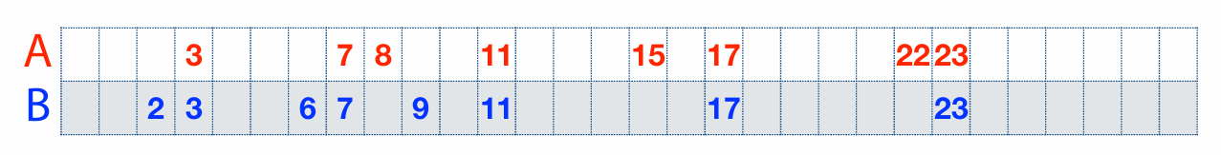
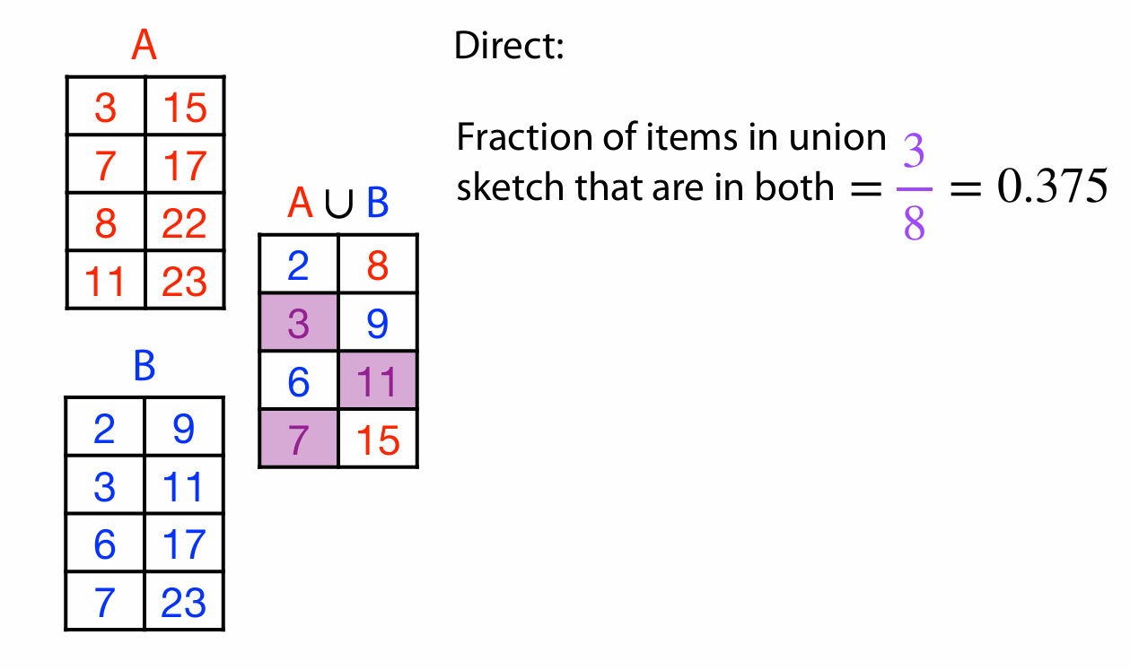
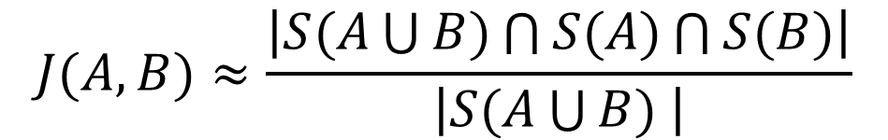



Jaccard similarity example
$$S(A)$$
$$S(A\bigcup{B)}$$
$$S(B)$$
$$J(A,B)≈\frac{\left|S(A\bigcup{B)\bigcap{S(A)}\bigcap{S(B)}}\right|}{\left|S(A\bigcup{B) }\right|}$$

Slide 4
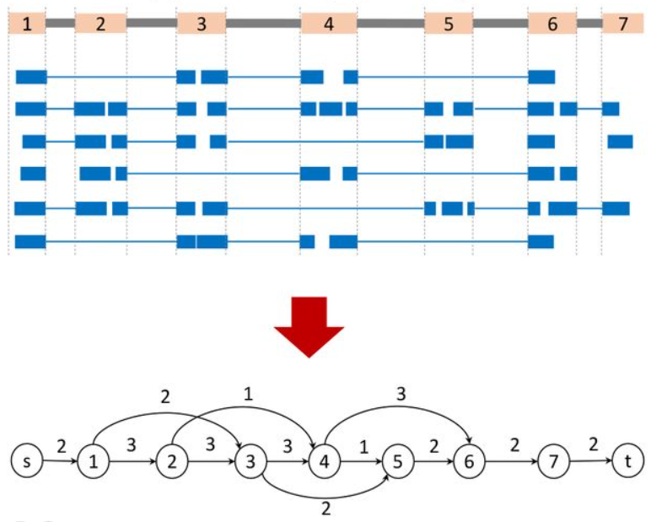
Assembly of aligned RNA-seq data
Image credit: https://www.biorxiv.org/content/10.1101/2024.02.09.579380v1.full
Use spliced alignments
Typically faster and more accurate
Build splice graph:
Nodes are exons
Edges are introns
Edge weight is the number of spliced reads
Remember that these data represent several linear transcripts

Slide 5
Assembly of aligned RNA-seq data
Image credit: https://www.biorxiv.org/content/10.1101/2024.02.09.579380v1.full
Can be solved as a variant of maximum flow problem
The problem: distribute paths(flows) between several linear transcripts
Algorithm:
Compute the path of heaviest coverage
Remove the reads used in the path
iterate

Slide 6
Assembly of aligned RNA-seq data
Image credit: https://www.biorxiv.org/content/10.1101/2024.02.09.579380v1.full
Path: 1-2-3-4-6 f=3

Slide 7
Assembly of aligned RNA-seq data
Image credit: https://www.biorxiv.org/content/10.1101/2024.02.09.579380v1.full
Path: 1-2-3-4-6 f=3
Remove reads used in the first path
Second path:1-3-5-6-7 f=2

Slide 8
Assembly of aligned RNA-seq data
Image credit: https://www.biorxiv.org/content/10.1101/2024.02.09.579380v1.full
Path: 1-2-3-4-6-7 f=3
Remove reads used in the first path
Second path:1-3-5 f=2
Remove reads used in the second path
Third path: 2-4-5 f=1

Slide 9
Evaluating transcript assembly
We want to compare the assembly output against a benchmark transcriptome where correct sequences of all transcripts are known.
Limitations of using a known reference transcriptome:
variability in the transcriptome (e.g. among e.g. cell types) makes it impossible to determine whether sequences from the reference that are missing from the assembled transcriptome are due to assembly errors, or whether they were not expressed in the library sequenced
transcriptome sequences may also vary between the individual under study and the reference

Slide 10
Common reference annotation databases

Slide 11
Benchmark transcriptome
We don’t have RNA-seq data from a transcriptome where all transcript sequences and expression patterns are known => simulate the sequencing of a given benchmark transcriptome to comprehensively assess all of the assembly errors.
Tools that can generate simulated reads modeling the errors and biases introduced by
short Illumina reads: RSEM, FluxSimulator, Polyester
long third- generation sequencing reads: PBSIM, Trans-NanoSim
Using simulated RNA-seq data allows the quantification of each of the following categories:
correctly assembled sequences (true positives or TPs)
sequences that are assembled with errors (false positives or FPs)
sequences in the reference that are missing from the assembly (false negatives or FNs)

Slide 12
Transcriptome assembly metrics
P – positive
N – negative
☺ TP – True Positive, we found correct transcript
☺ TN – True Negative, we did not find transcript where there was none
☹ FP – False Positive, we found transcript where there was none
☹ FN – False Negative, we missed transcript
P = TP + FN
N = TN + FP

Slide 13
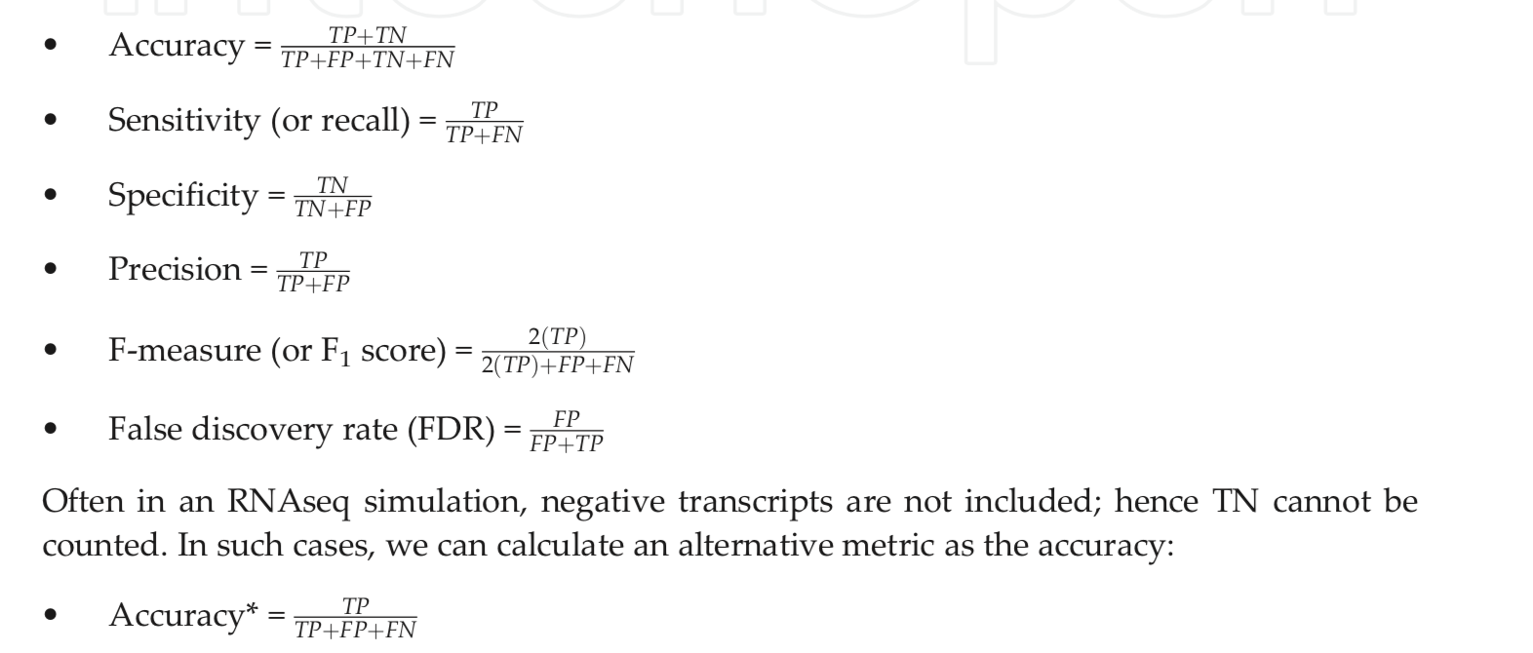
Assembly metrics based on benchmark
P = TP + FN
N = TN + FP

Slide 14
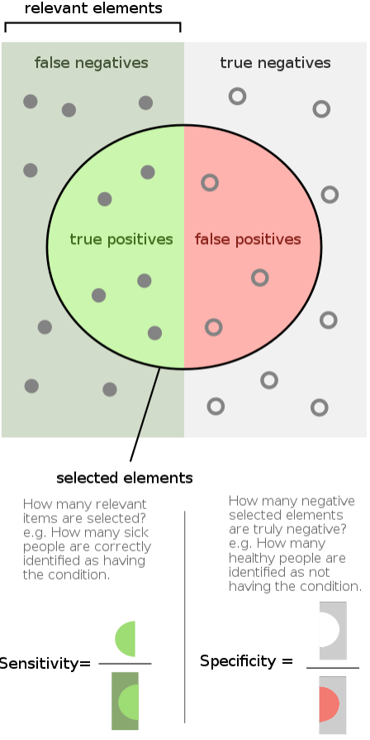
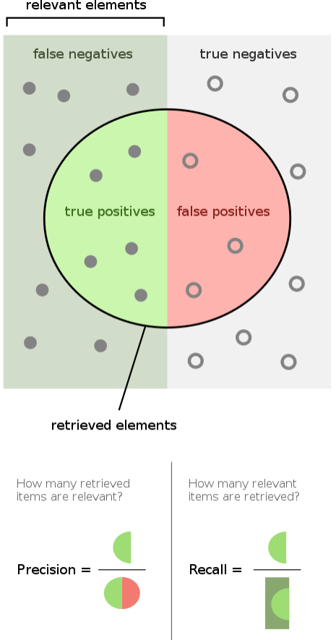
Measures of correctness
Sensitivity (Recall), Specificity and Precision
Image credit: Wikipedia

Slide 15
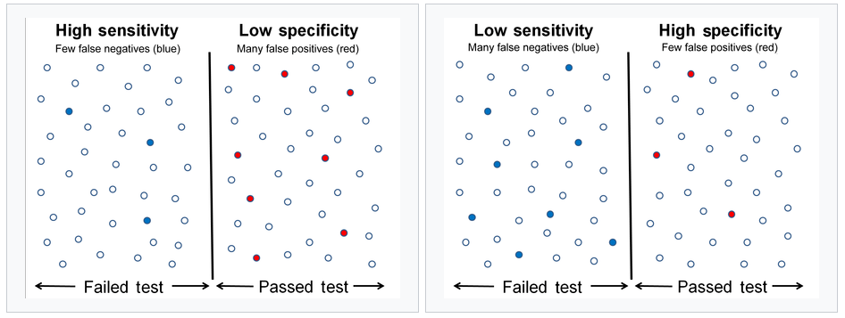
Sensitivity and Specificity

Slide 16
Intron chain
Intron chain is the set of numbers corresponding to the start and end exon coordinates for spliced exons
Intron chain also records the strand (+, or forward) or (-, or reverse)
Intron chain here is (+) i₁, i₂, i₃, i₄, i₅, i₆
Ignores start and end coordinates
Coding start
Coding stop
i₁
i₂
i₃
i₄
i₅
i₆

Slide 17
Nucleotide level accuracy
TN
FN
TP
FP
TN
FN
TP
FN
TN
REALITY
ASSEMBLY
Sensitivity:
Precision:

Slide 18
Exon level accuracy
WRONG EXON
CORRECT EXON
MISSING
EXON
REALITY
ASSEMBLY
Exon Sensitivity
Exon Precision
“Junction ends” must match exactly, beginning or end do not!

Slide 19
Transcript level accuracy
< 80%
REALITY
ASSEMBLY
WRONG!
Same INTRON CHAIN => CORRECT!
CORRECT!

Slide 20

gffread, gffcompare and trmap
gffread, gffcompare and trmap
- a fast tool for verification, filtering and conversion of the most popular annotation file formats (GTF, GFF3, BED) and for quick extraction of transcript sequences from the genome sequence.
FASTA:
GFF/BED:
gffread -w
http://ccb.jhu.edu/software/stringtie/gff.shtml

Slide 21
gffread, gffcompare and trmap
gffread, gffcompare and trmap
- a tool for merging and tracking transcript structures across multiple samples and comparing them to a reference annotation.
exon 1
exon 2
exon 3
exon 4
Reference
transcripts
isoform 1
isoform 2
Sample 1
transfrags
Sample 2
transfrags
Merged
transcripts
http://ccb.jhu.edu/software/stringtie/gff.shtml

Slide 22
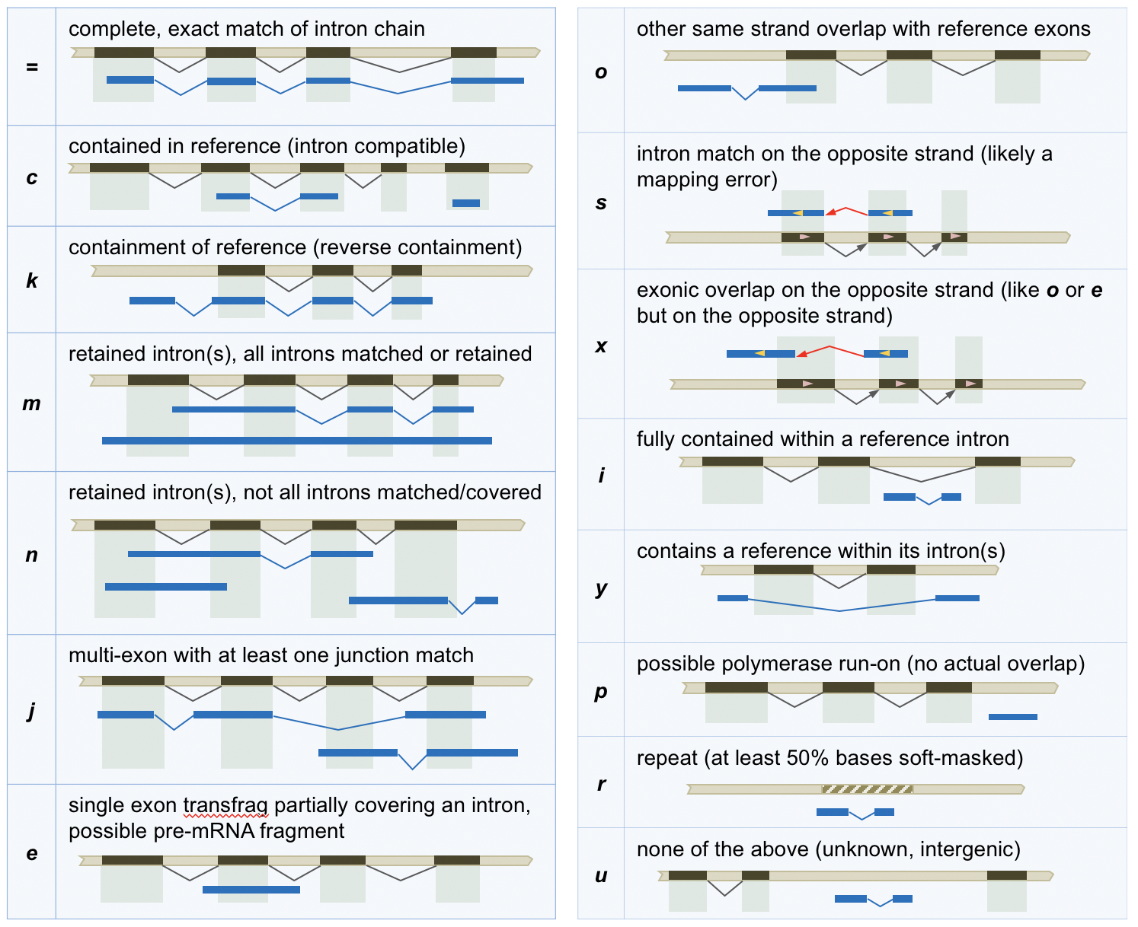
gffread, gffcompare and trmap
gffread, gffcompare and trmap
- a tool for merging and tracking transcript structures across multiple samples and comparing them to a reference annotation.
http://ccb.jhu.edu/software/stringtie/gff.shtml

Slide 23
gffread, gffcompare and trmap
gffread, gffcompare and trmap
- designed for large scale overlap analysis of streaming transcript prediction data (millions of transcripts) with a reference annotation data set; it performs detection and classification of all the overlaps found between the streamed transcripts and the reference annotation transcripts.
http://ccb.jhu.edu/software/stringtie/gff.shtml

Slide 24
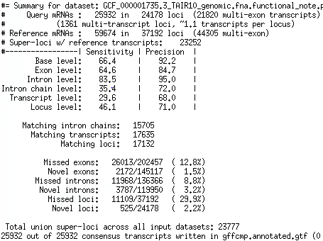
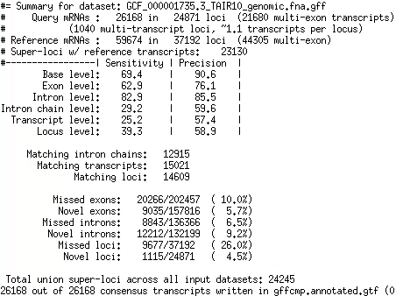
gffcompare of two annotations

Slide 25
gffcompare of two annotations

Slide 26
Ab initio gene finding
Transcriptome sequencing data does not provide comprehensive picture of expression – not all transcripts are expressed in all cells at the same time:
Sequence many different cells under many conditions (expensive)
Supplement transcriptome sequencing data with an ab initio gene finding algorithm to find transcripts that a not expressed
Assembled transcripts have errors:
Use machine learning algorithms to detect errors in assembled transcripts
Machine learning:
Positional Weights/Markov chain/Hidden Markov Models
Convolution Neural Networks?

